Slide 1
Chapter 15
Dimensionality Reduction
Motivation Ⅰ: Data Compression
Second Unsupervised learning algorithm

Slide 2
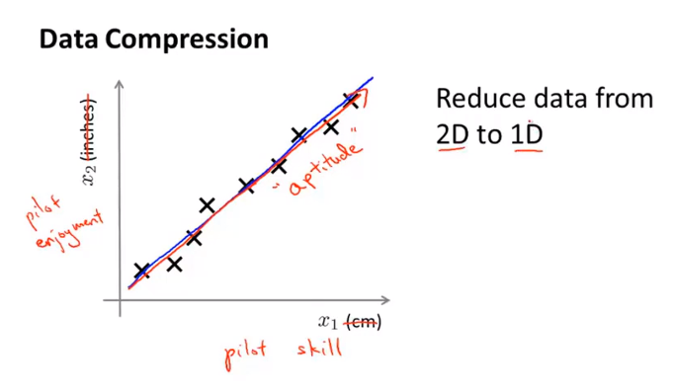
Chapter 15

Slide 3
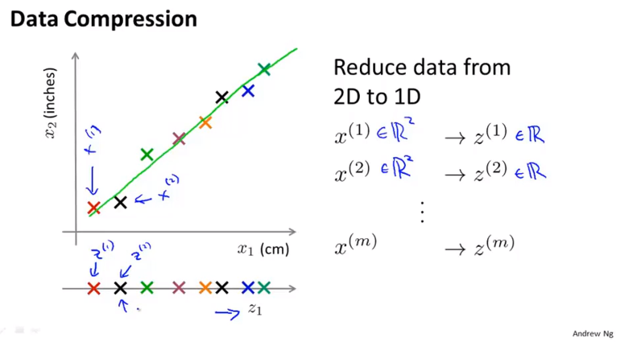
Chapter 15
By projecting all of my original examples onto this green line over here, then I need only one number, I need only one real number to specify the position of the point on the line, and so what I can do is therefore use just one number to represent the location of each of my training examples after they’ve been projected onto that green line. So this is an approximation to the original training set. And this halves the memory requirement or the data place requirement where have you, for how to store my data.
This allow us to make our learning algorithms run more quickly as well.

Slide 4
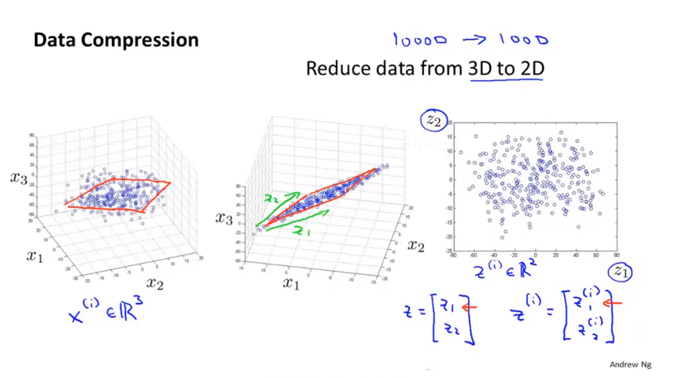
Chapter 15
3D point cloud(点云)

Slide 5
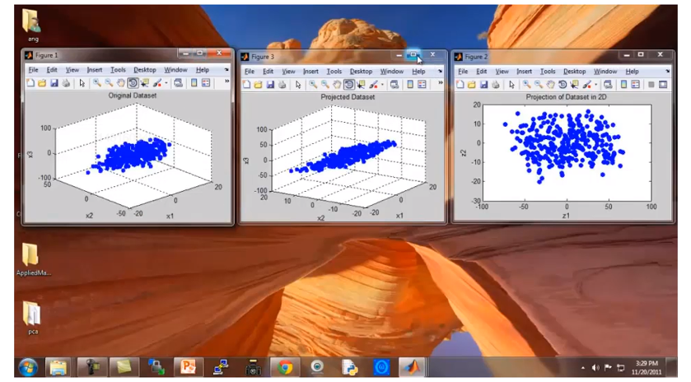
Chapter 15

Slide 6
Chapter 15
Dimensionality Reduction
Motivation Ⅱ: Data Visualization

Slide 7
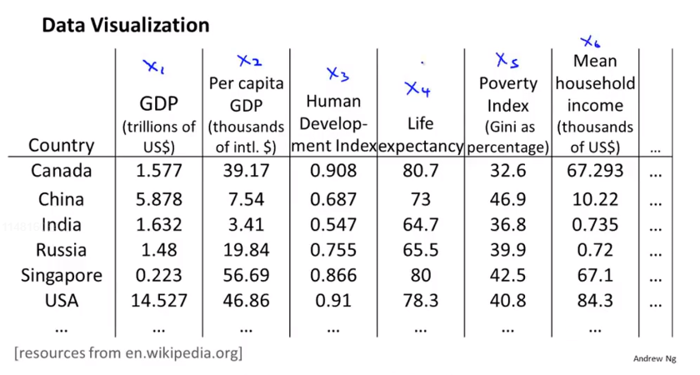
Chapter 15

Slide 8
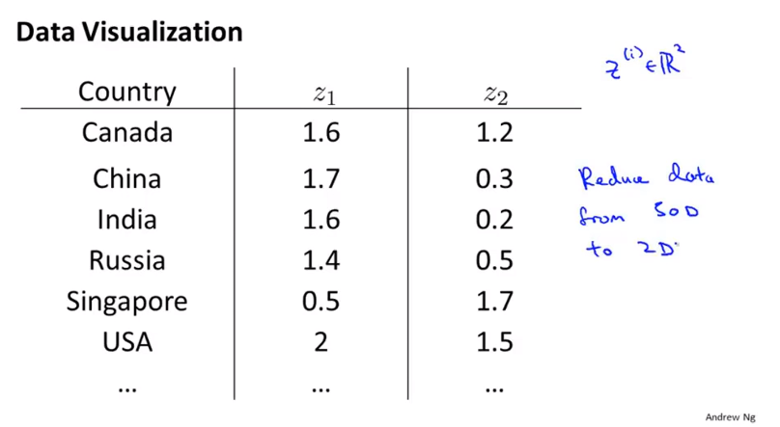
Chapter 15
You can plot this as a 2 dimensional plot. And when you do that, it turns out that, if you look at the output of the Dimensionality Reduction algorithm, it usually doesn’t astride a physical meaning to these new features you want the Z to. It’s often up to us to figure out roughly what these features means

Slide 9
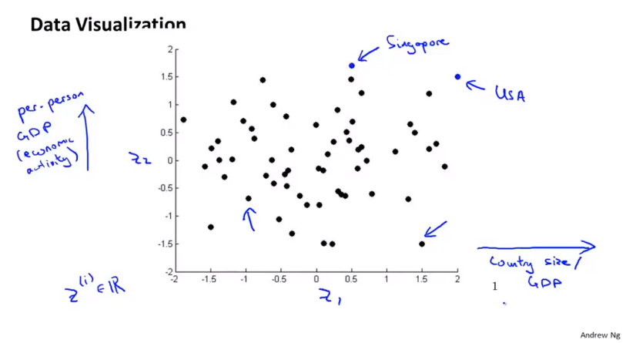
Chapter 15
So you might find that the axes Z1 and Z2 can help you to most succinctly capture really what are the two main dimensions of the variations amongst different countires.

Slide 10
Chapter 15
Dimensionality Reduction
Principal Component Analysis problem formulation
By far the most popular, by far the most commonly used algorithm is something called principal components analysis or PCA.
Try to formulate precisely exactly what we would like PCA to do.

Slide 11
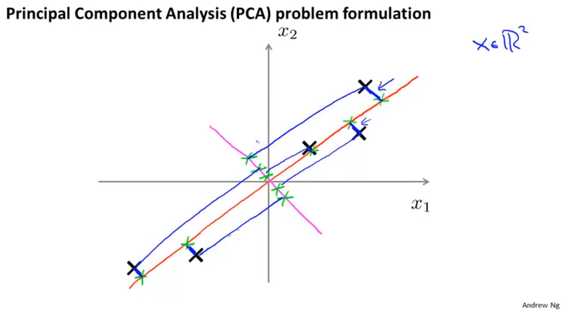
Chapter 15
So what PCA does, formally, is it tries to find a lower-dimensional surface, really a line in this case, onto which to project the data, so that the sum of squares of these blue little line segments is minimized. The length of those blue line segments, that sometimes also called the projection error.

Slide 12
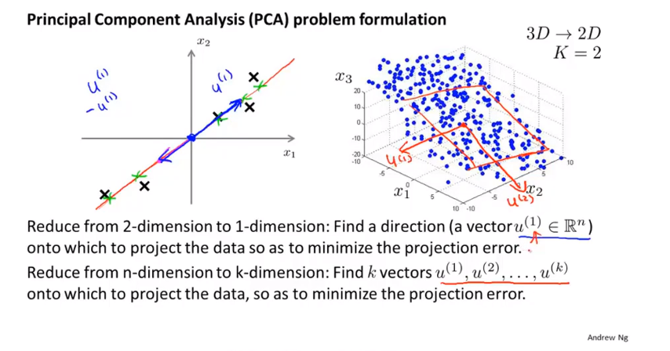
Chapter 15
We can define the position of the points in the plain using the K directions. That’s why for PCA, we want to find k vectors onto which to project the data. And so more formally, in PCA what we want to do is find this way to project the data so as to minimize the sort of projection distance, which is the distance between points and projections. Try to minimize that squared projection, that 90 degree, or that orthogonal projection error.

Slide 13
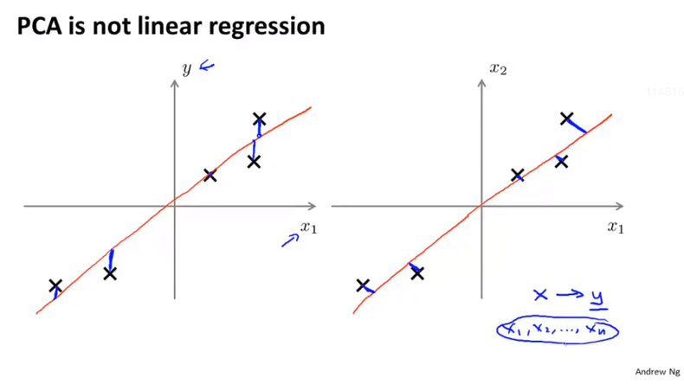
Chapter 15
More generally, when you doing linear regression, there is this distinguished variable y that we’re trying to predict, all that linear regression is about is taking all the values of X and try to use that to predict y. Whereas in PCA, there is no distinguished or there is no special variable y that we’re trying to predict, and instead we have a list of features x1, x2, and so on up to xn, and all these features are treated equallt.

Slide 14
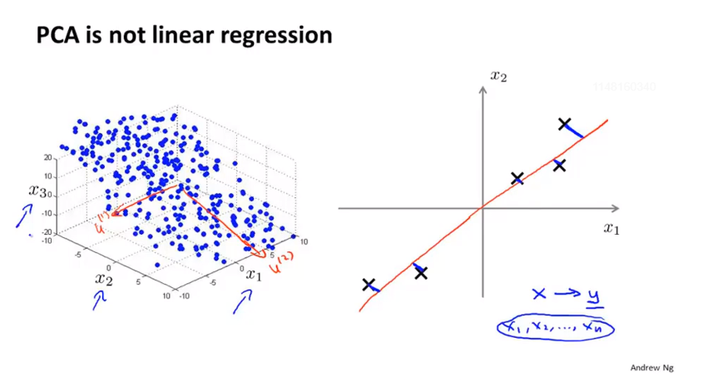
Chapter 15

Slide 15
Chapter 15
Dimensionality Reduction
Principal Component Analysis algorithm

Slide 16
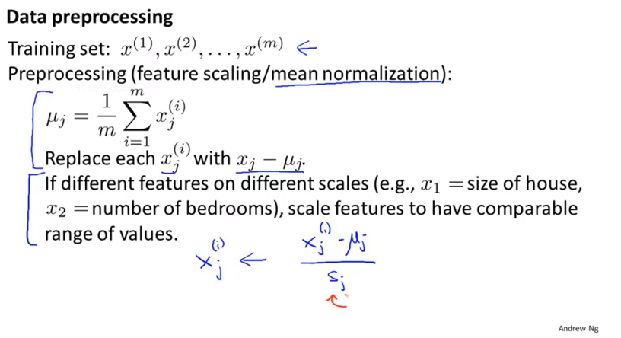
Chapter 15
Sj could be the max minus min value or more commonly, it is the standard deviation of feature j.

Slide 17
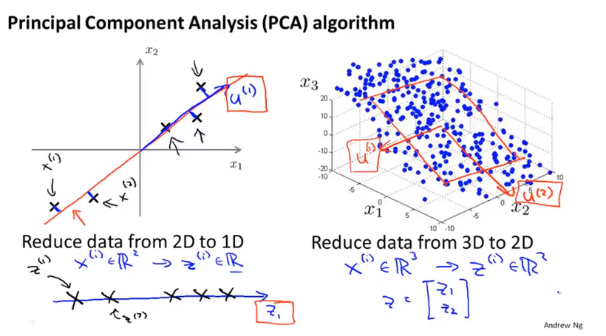
Chapter 15
What PCA does is, it tries to find a lower dimensional sub-space onto which to project to the data,
so as minimize the squared projection errors, the sum of the squared projection errors, as the square of the length of those blue lines.

Slide 18
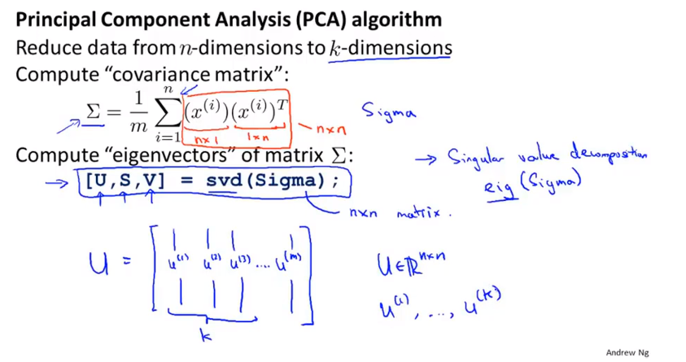
Chapter 15
Covariance matrix(协方差), denote by capital sigma. svd Singular Value Decomposition
eigenvectors(特征向量)
Covariance matrix always satisfy a mathematical property called symmetric positive definite.

Slide 19
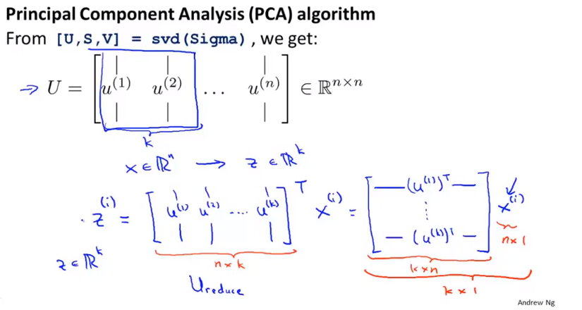
Chapter 15

Slide 20
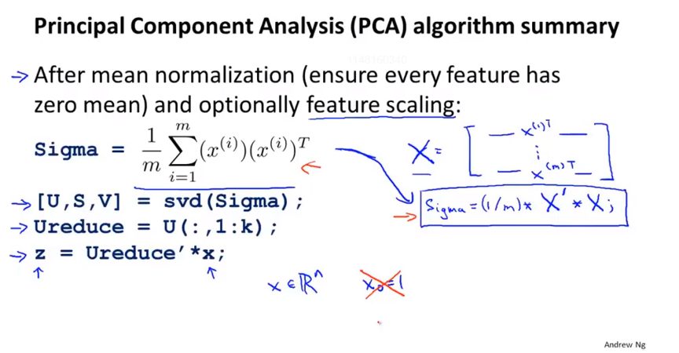
Chapter 15

Slide 21
Chapter 15
Dimensionality Reduction
Choosing the number of principal components

Slide 22
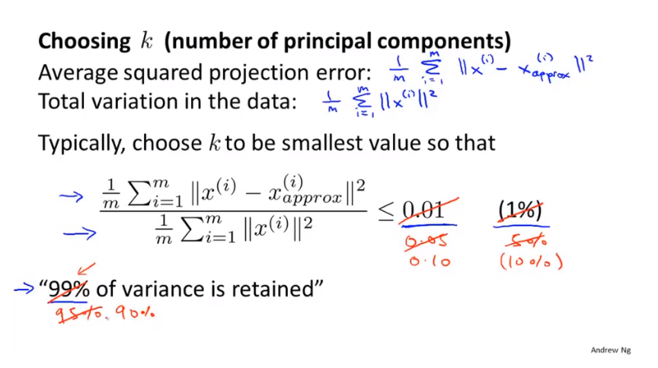
Chapter 15
For most real life data says many features are just highly correlated. So it turns out to be impossible to compress the data a lot and still retain you know 99% of the variance.

Slide 23
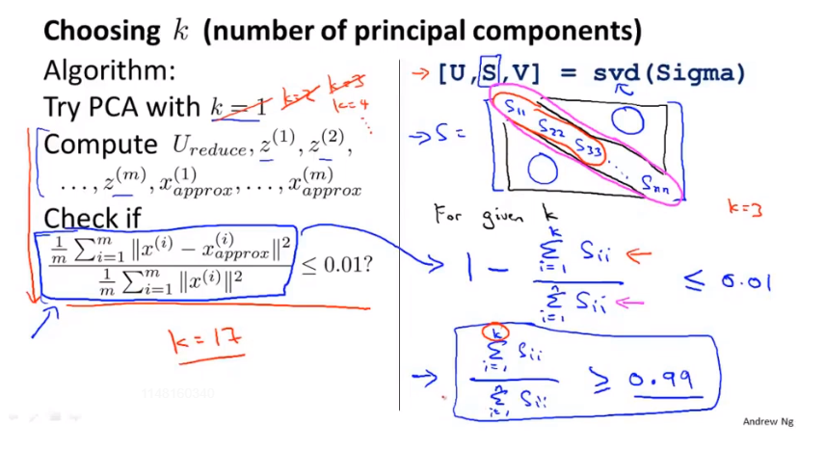
Chapter 15

Slide 24
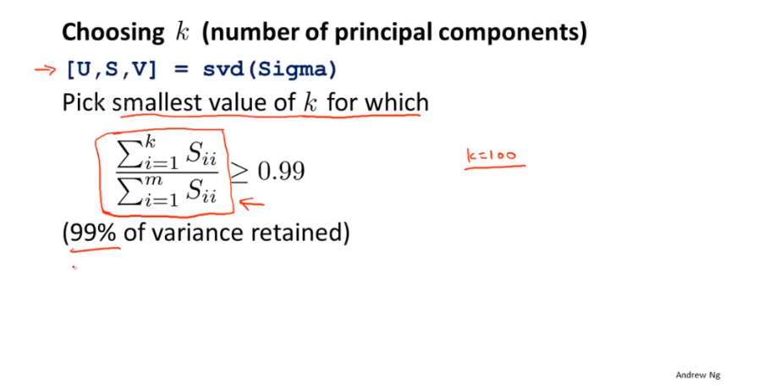
Chapter 15
With PCA, people can use this to try to get a good understanding of how well your hundred dimensional representation is approximating your original data set. Because there’s 99% of
variance retained. That’s really a measure of your square of construction error that ratio being 0.01,just give people a good intuitive sense of whether your implementation of PCA is find a good approximating of your original data set.

Slide 25
Chapter 15
Dimensionality Reduction
Reconstruction from compressed representation
From this compressed representation , back to an approximation of your original high dimensional data.

Slide 26
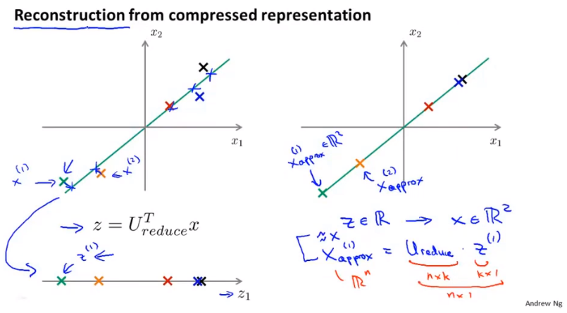
Chapter 15

Slide 27
Chapter 15
Dimensionality Reduction
Advice for applying PCA
PCA can be sometimes used to speed up the running time of a learning algorithm.

Slide 28
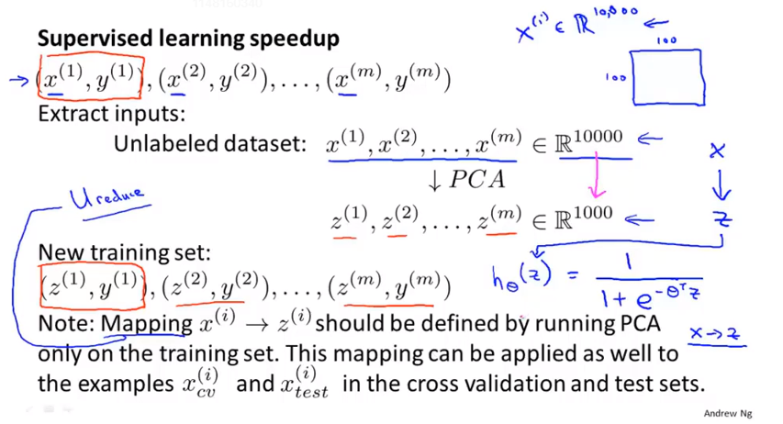
Chapter 15
With PCA we’ll be able to reduce the dimensionof data and so make our algorithm run more efficiently.
Run your PCA only on your training set portion of the data, not the cross-validation set or the test portion of your data. And that define the mapping from x to z…
For many problems, we actually reduce the dimensional data, you know by 5x maybe 10x, and still retain the most of the variance and to do this with barely effecting the performance.
And by suing lower dimension data, our learning algorithm can often run much faster.

Slide 29
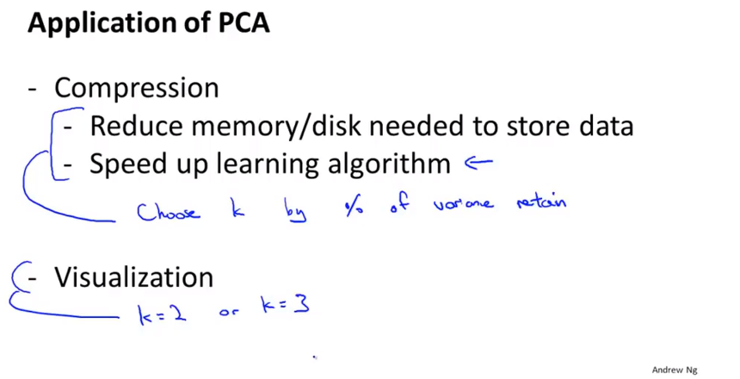
Chapter 15

Slide 30
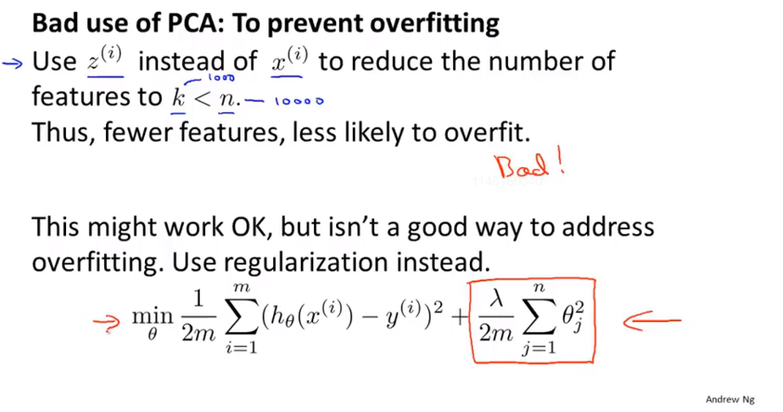
Chapter 15
When you are applying linear regression or logistic regression or some other method with regularization, well, this minimization problem actually knows what the values of y and so is less likely to throw away some valuable information whereas PCA doesn’t make use of the labels and is more likely to throw away valuable information.

Slide 31
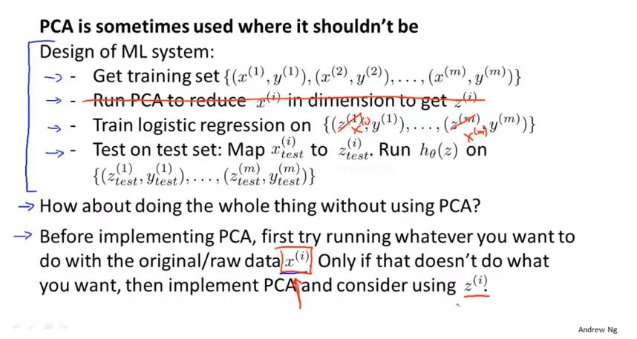
Chapter 15
Consider PCA as an alternative as well.
So that if your learning algorithm ends up running too slowly or only if the memory requirement or the disk space requirement is too large, so you want to compress your representation but only if using the raw xi doesn’t work, only if you have evidence or strong reason to believe that using the xi won’t work, the implement PCA and consider suing the compressed representation.

Slide 32
Chapter 15
Despite these last sets of comments, PCA is an incredibly useful algorithm when you use it for the appropriate applications and I’ve actually used PCA pretty often and for me it mostly to speed up the running time of my leaning algorithms. Just as a common application of PCA, is to use it to compress data, to reduce the memory or disk space requirements or to use it to visualize data.
And PCA is the most commonly used and one of the most powerful unsupervised learning algorithms.

